Slide 1

THE RESTURANT MANAGEMENT SYSTEM
Team Members
Hung Phung
Sajit Khadka
Sanjeev Deshar
Prekshya Aryal

Slide 2
AGENDA
Technology used
Introduction
Why this project?
Architecture of the Project
Problems faced and solutions
Work Division
Result and Presentation Conclusion
References

Slide 3


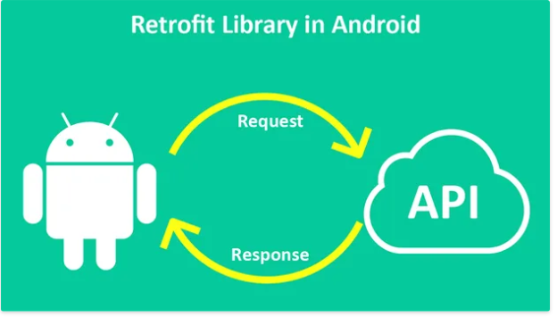



TECHNOLOGY USED

Slide 4
INTRODUCTION
Application targeted for the restaurant.
Helps restaurant to manage their food ordering system and keep tracks of the sales/ profits
App provides table status(empty or occupied), helps waiter to take order and when the order is confirmed, it goes to cook’s end where cook change the food status from in line to cooking and when food is ready then to “Ready”.
Waiter can see food status hence serves the food and changes the status to served.
Consists of three logins : for waiter, cook and managers/Admin

Slide 5

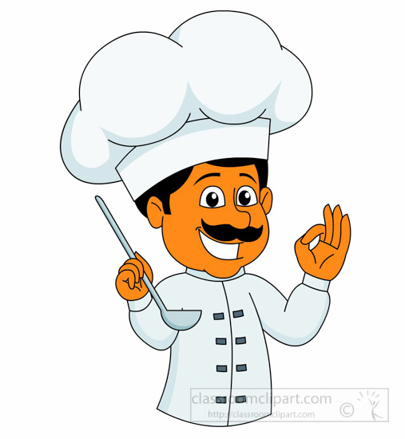
Waiter (can see)
- Table information (status : empty or occupied)
- Order food from customer
- View food status: cooked / ready to serve
- Serves the food once the food status is ready and then
changes the status to served
- Perform Payments
Cook
- screen shows food lists (to be prepared)
- has two option (can change food status ->from cooking to ready)
- once food is ready , changes food status to ready.
Manager /Admin
- Has access to all the user
- Can view or access both waiter and cook

Slide 6


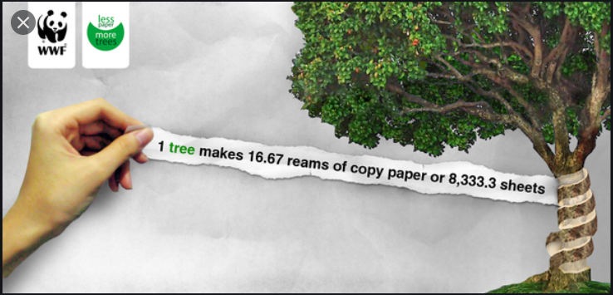

Lots of restaurant are still using the traditional method and its time to advance with the technology.
Traditional Method - Every activities like orders, sales, profit are recorded in the paper -- Difficult to track and manage the sales at the end of the year.
Each sales activities are stored in the database
- helps to track and manage sales/profits
Saves Tree
- app promotes online data storage + provides electronic receipts
- less use of paper
- contributes in
saving planet.

Slide 7
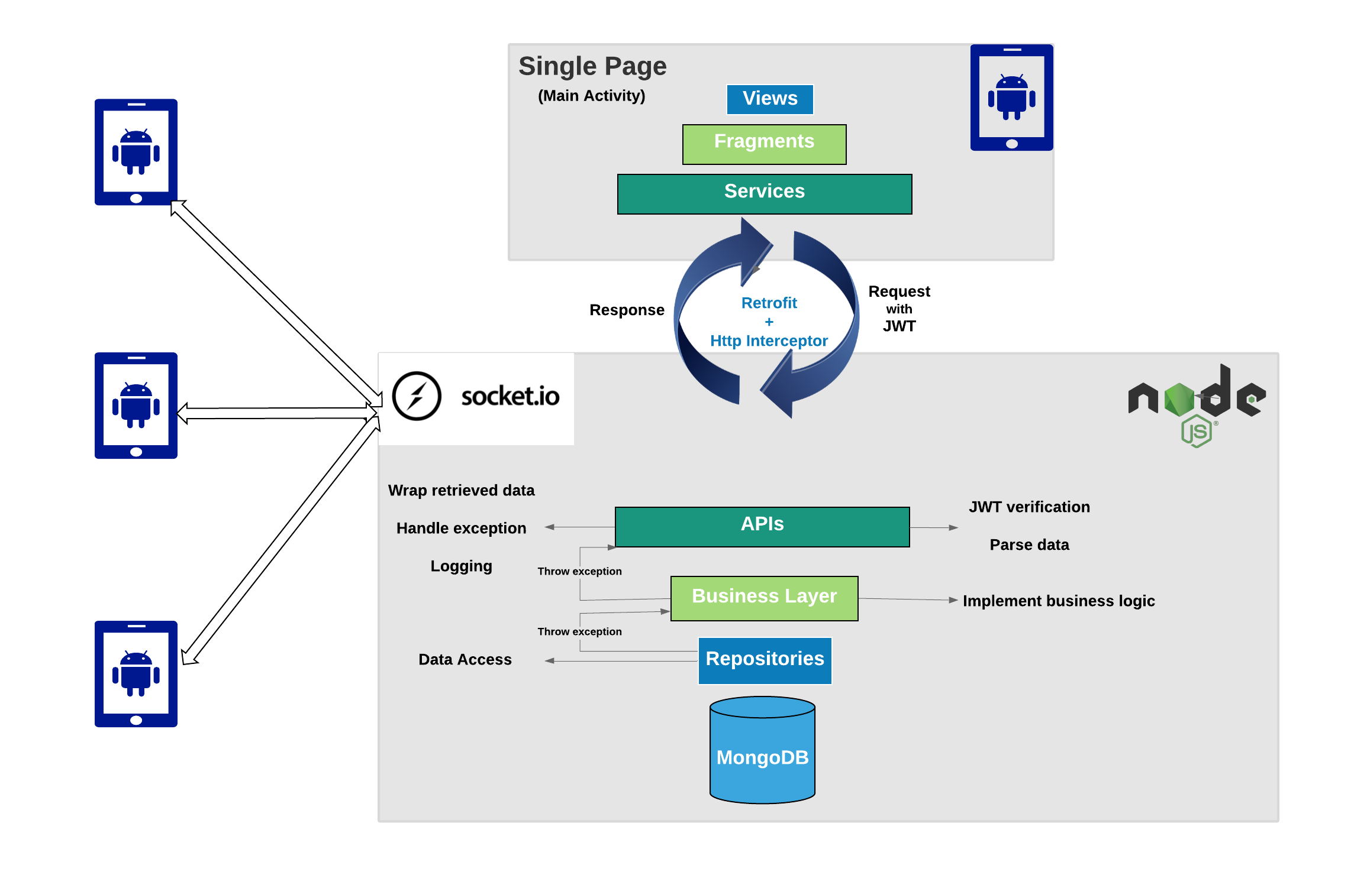
ARCHITECTURE

Slide 8
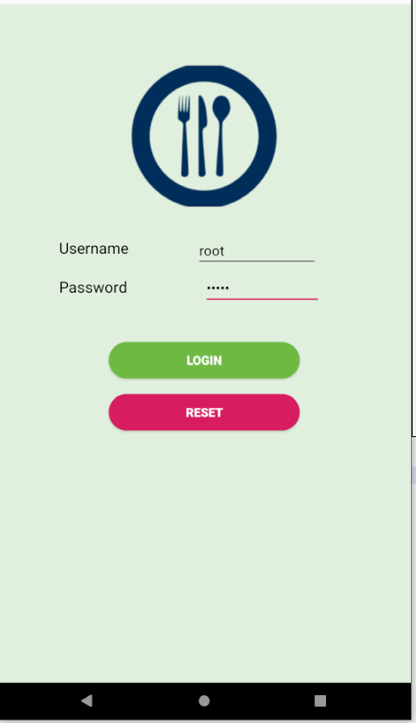
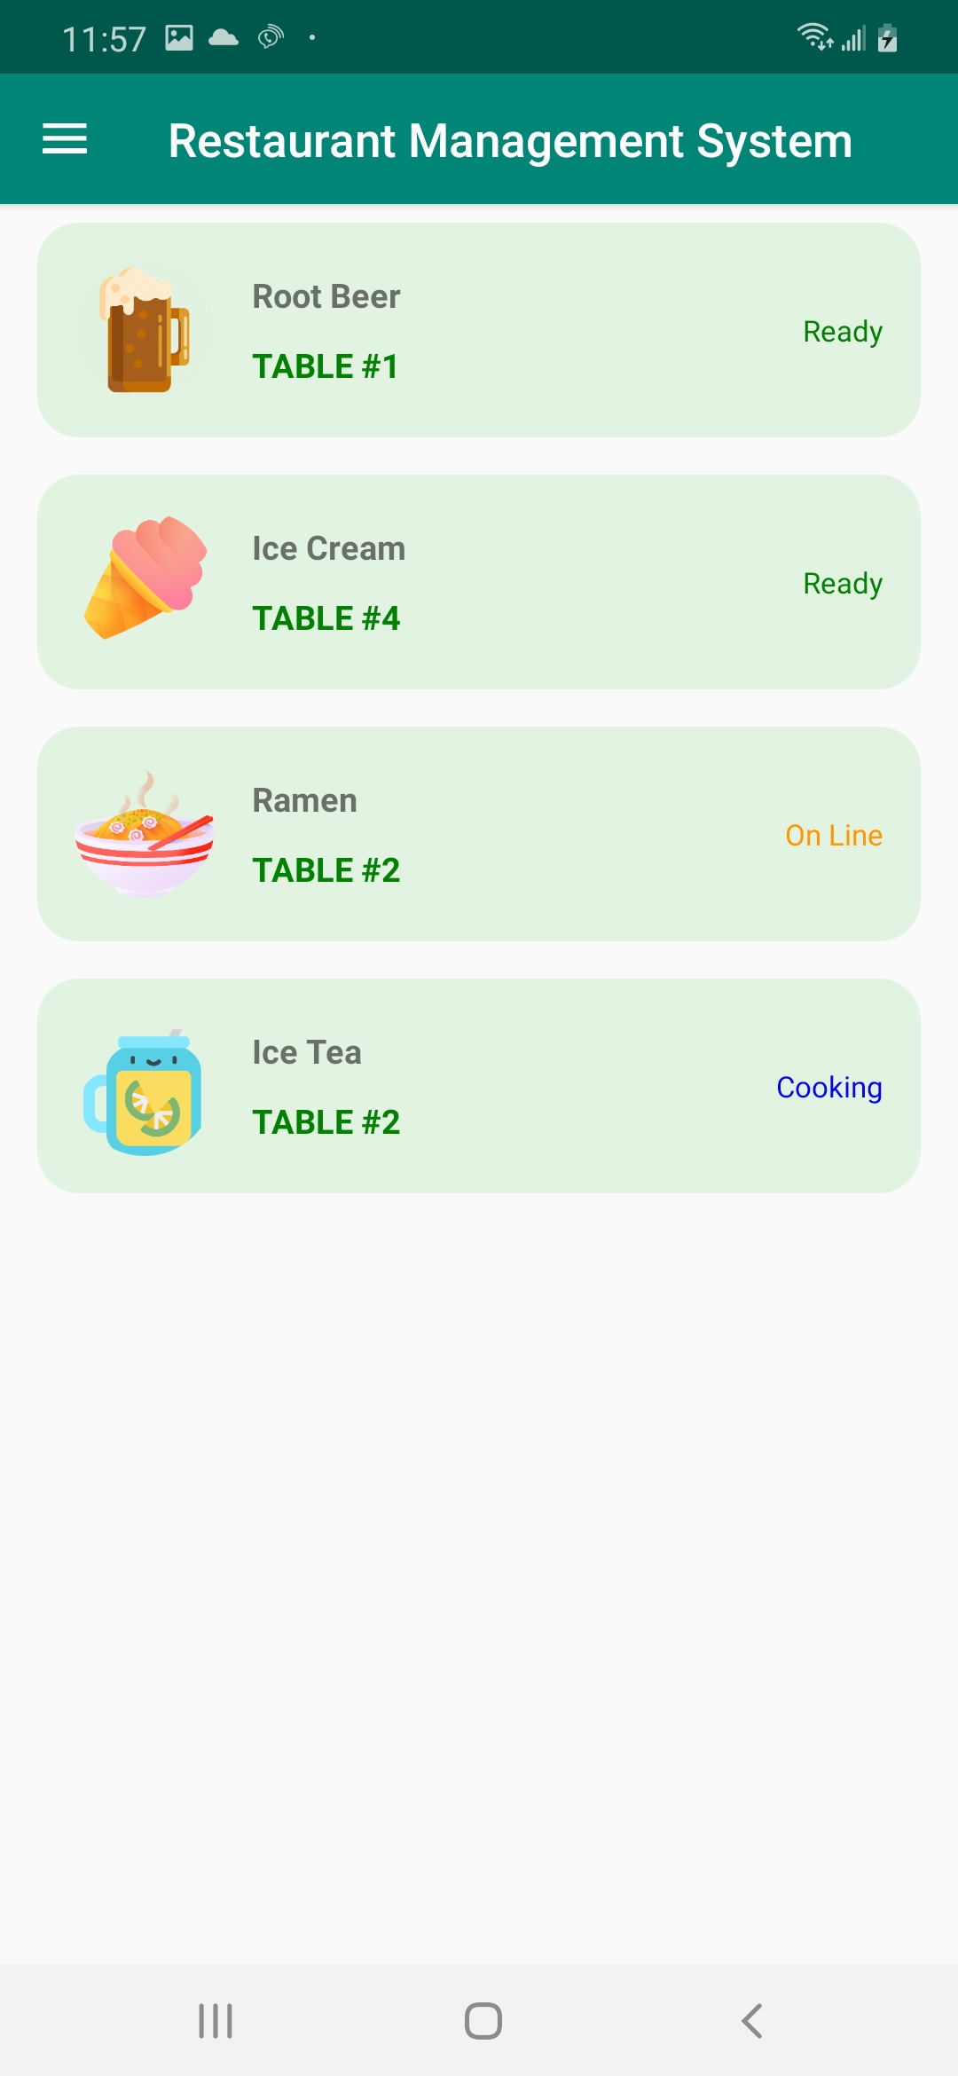
IMPLEMENTATION
Api/table/getAllOrderedFoodByRole
Recycler View
login: /auth/login

Slide 9
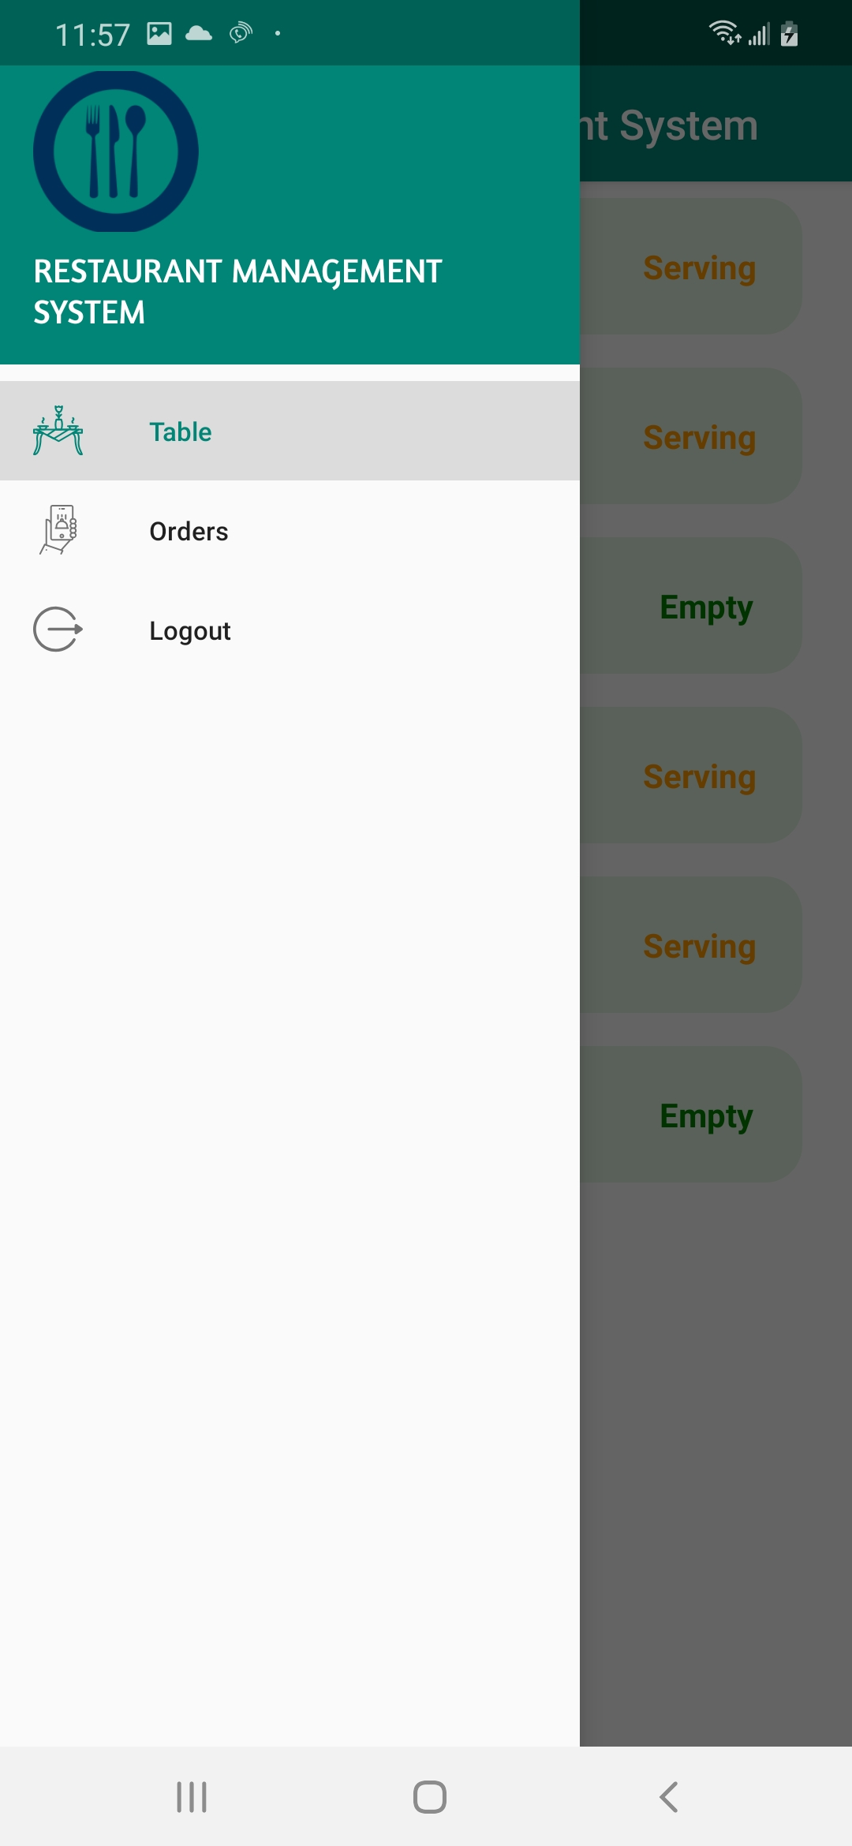
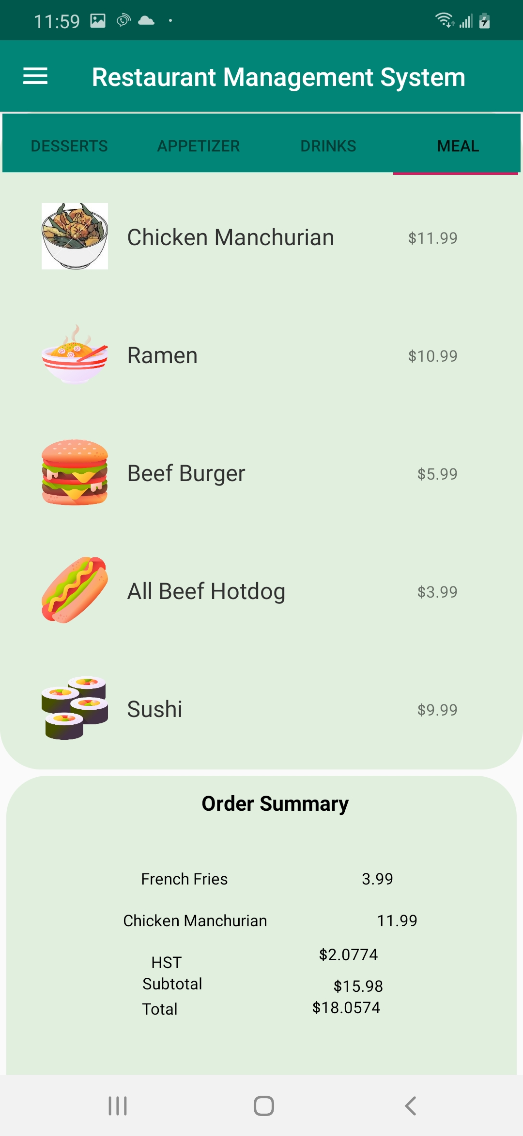
IMPLEMENTATION
Api foods/getAllFoods
Tab layout
Viewpager
recyclerview
Menu
fragments

Slide 10
PROBLEMS
New technologies
Very limited time
Communication
Manage tasks & progress
Source control, code conflicts
Bugs ☺
Hosting

Slide 11
SOLUTIONS
Uncountable hours on researching & learning new technologies
Virtual meetings
MS Excel to manage tasks progress
Git

Slide 12
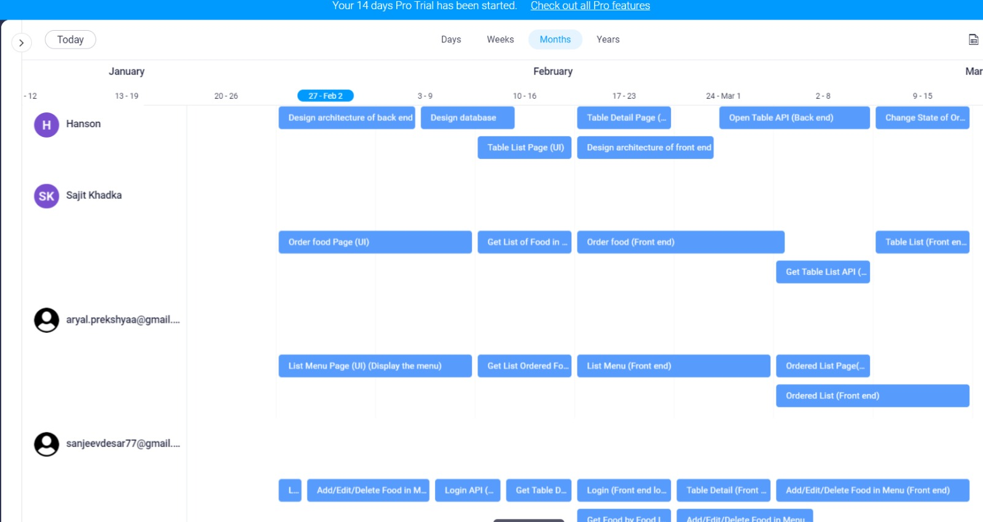
WORK DIVISION

Slide 13
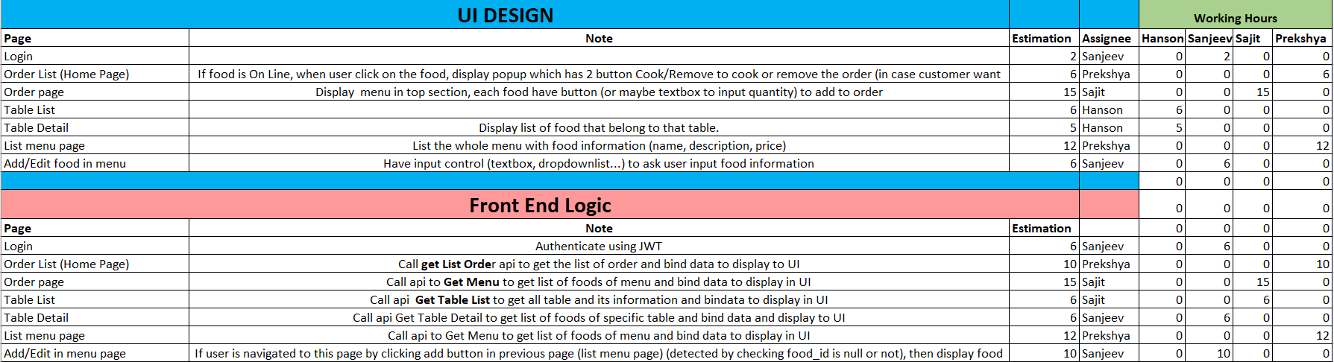

Slide 14
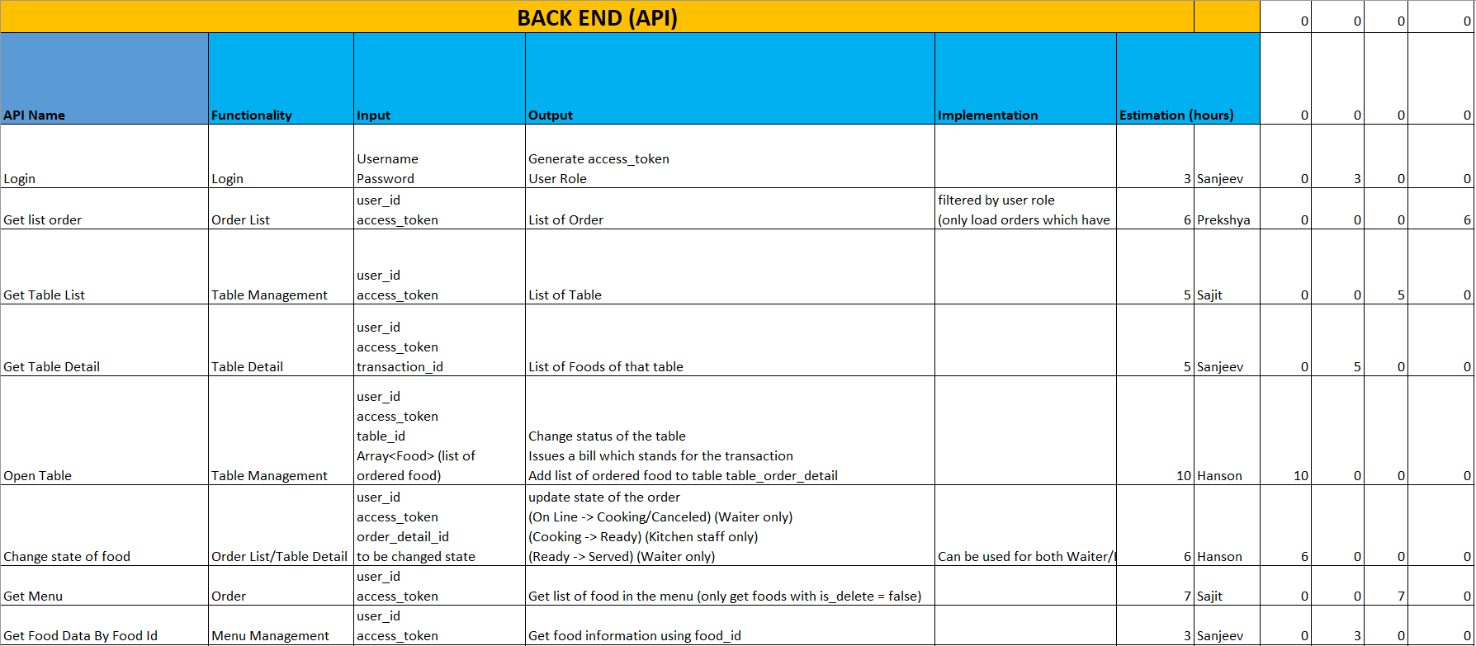

Slide 15
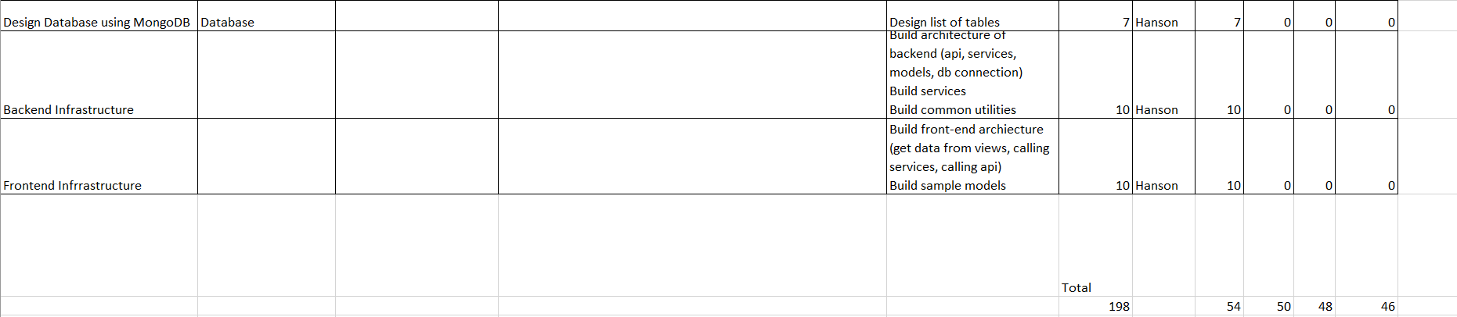

Slide 16
RESULT AND PRESENTATION CONCLUSION
Proper time management, hard work and task division lead to successful completion of the project.
Still room for future improvements such as sales data analysis, admin or manager features such as managing users and food menus and much more.
During the implementation we were able to learn not just the android and coding part but more about working in a team, especially online.
We learned many technologies other than just core android as they were needed in order for the project to be complete.

Slide 17
REFERENCES
https://www.theverge.com/2019/8/22/20827231/android-10-q-google-name-officially-announced-new-logo-wordmark-desserts
https://airbrake.io/blog/java-exception-handling/inputmismatchexception
https://blog.logrocket.com/design-patterns-in-node-js-2/
https://www.shutterstock.com/search/why+icon
http://www.hrbaptist.ca/sermonarchive/now-that-im-a-christian-how-should-i-vote/
https://venusandvagabonds.wordpress.com/
http://ddargoesgreen.blogspot.com/2016/04/introduction-to-ddar-less-paper-campaign.html
https://classroomclipart.com/clipart-view/Clipart/Culinary/chef-cooking-and-tasting-food-with-happy-face-clipart_jpg.htm
https://webstockreview.net/explore/catering-clipart-hotel-server/

Slide 18
THANK YOU

